Slide 1

IIIT Bhubaneswar
1
Department Of Computer Secience & Engineering

Slide 2
MAJOR PROJECT PRESENTATION
Project Name: Real Time Human Pose Estimation
Project Members Name
Shrey Sahay B421047
Piyush Kumar Nayak B521044
Hemant Sah
B421025

Slide 3
INDEX
S.No | Topics | Page No
1. | Constraints | 4
2. | Introduction | 5
3. | Types Of Pose Estimation | 6
5. | Libraries | 7 - 12
6. | Flow of Project | 13 - 14
7. | Website Home Page | 15
8. | Use Cases | 16
9. | The Future Scope | 17
10. | Conclusion | 18

Slide 4
CONSTRAINTS
Pose estimation is a vast topic and considering their types (2D pose estimation and 3D pose estimation) we had restricted our project to the 2D pose estimation which is the estimation of keypoints of object or image along x and y coordinate.
On the other hand the implementation can be done in several ways. But we will estimate the single and multi pose with the help of Browser.
Here we are not going to train the Machine Learning models, instead we had used java script libraries which have inbuilt capabilities of Machine Learning and just by using some import commands we will have access to those Machine Learning models.

Slide 5
INTRODUCTION
‹#›
The Human Pose Estimation is the task of using a machine learning model to estimate the approximate pose of a person from an image or a video by estimating the spatial locations of key body joints that is called keypoints.
The Aim of this project is to deliver the basic use cases of the Pose Net model for real-time human pose estimation using a webcam feed as the data.
TensorFlow.js is a JavaScript library that enables the training and deployment of machine learning models in the browser.

Slide 6
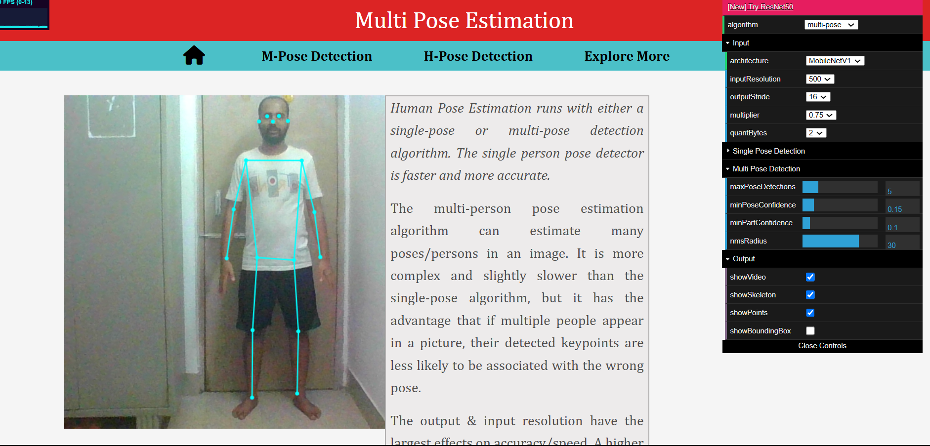
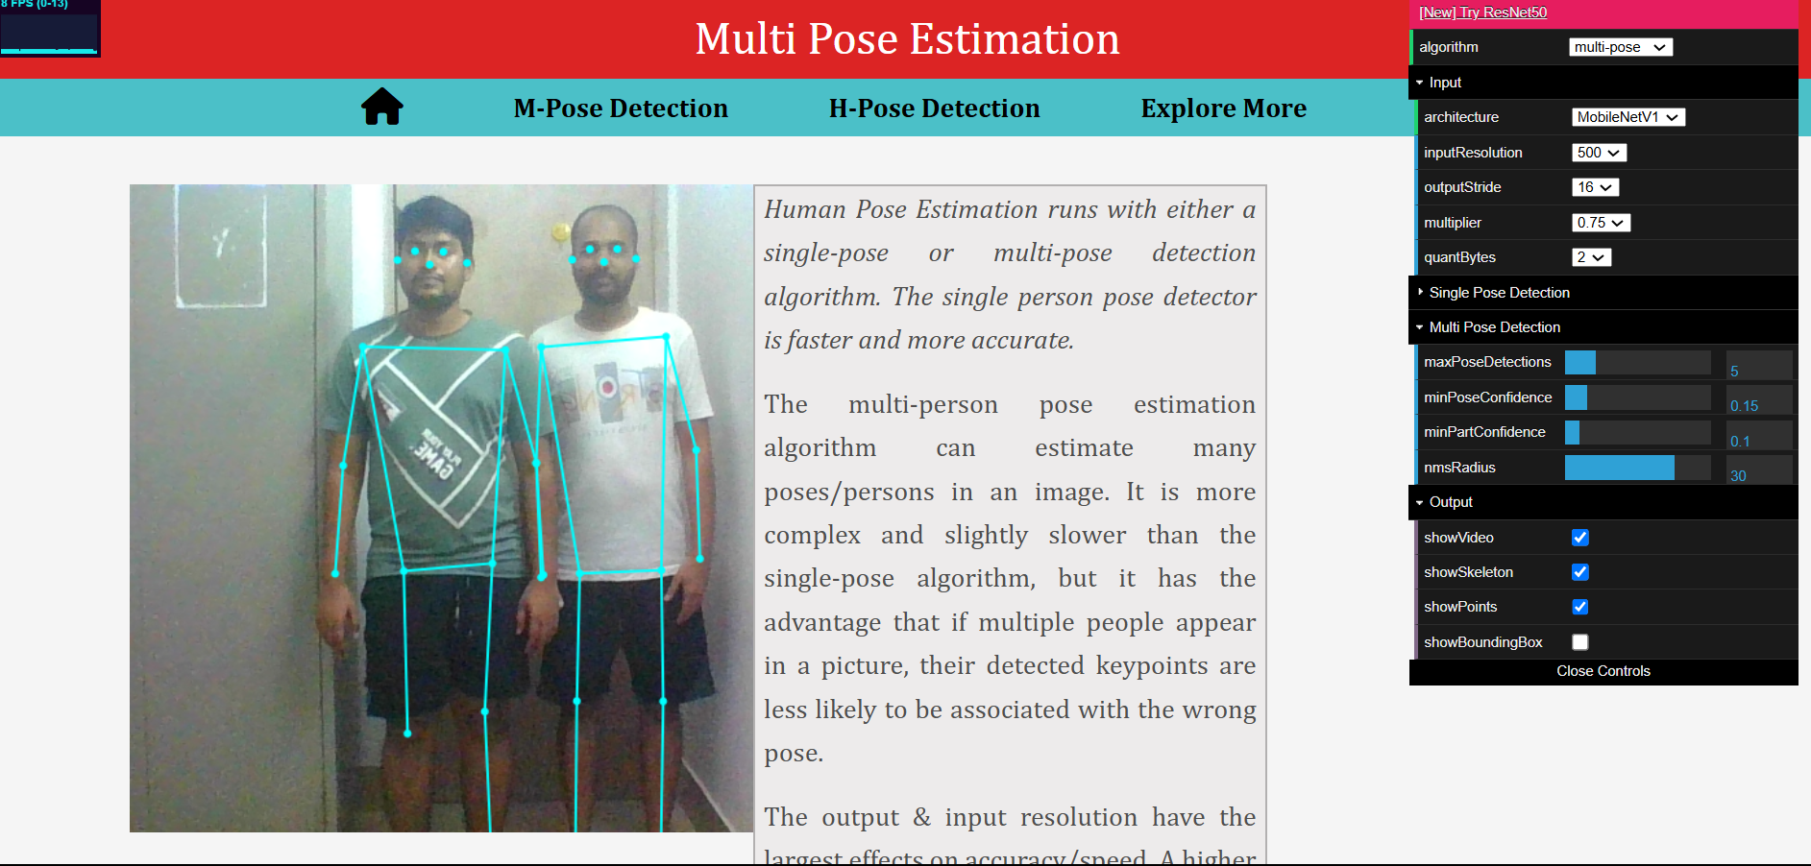
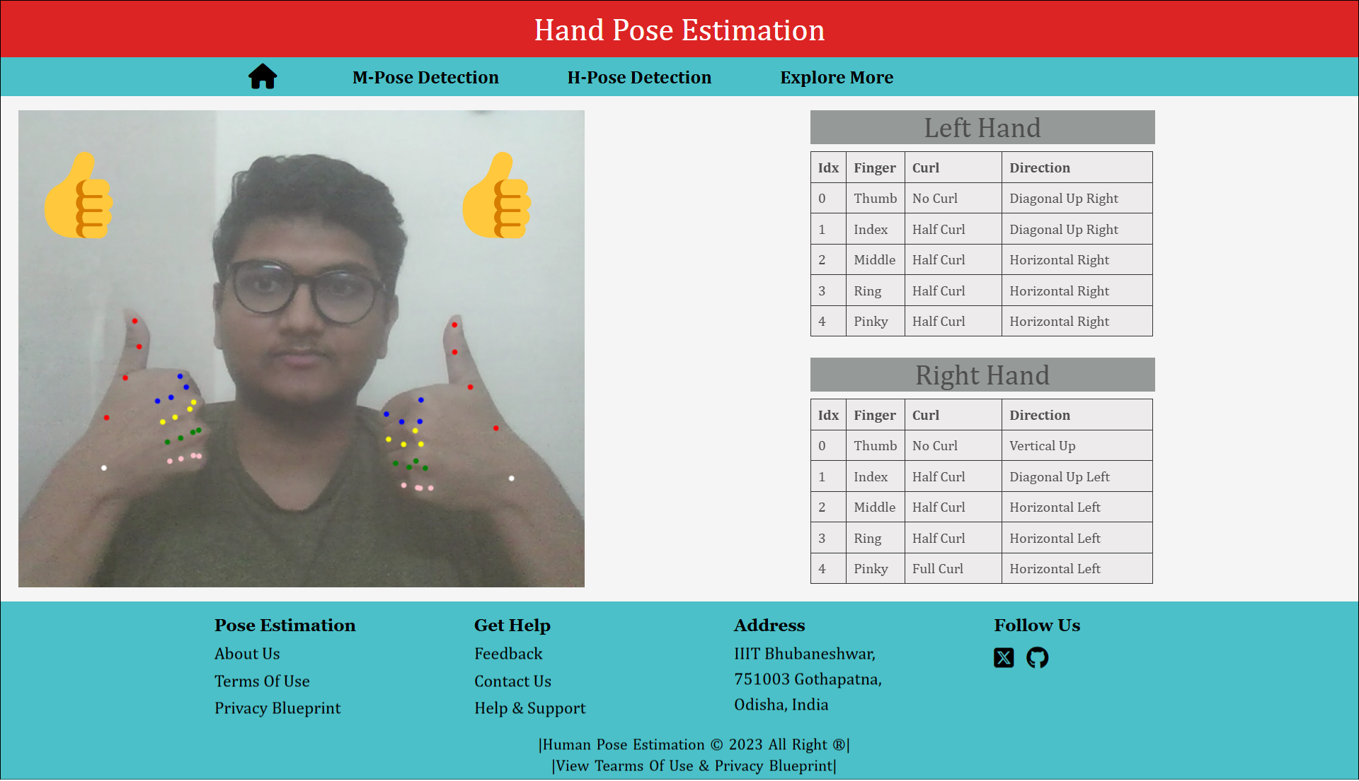
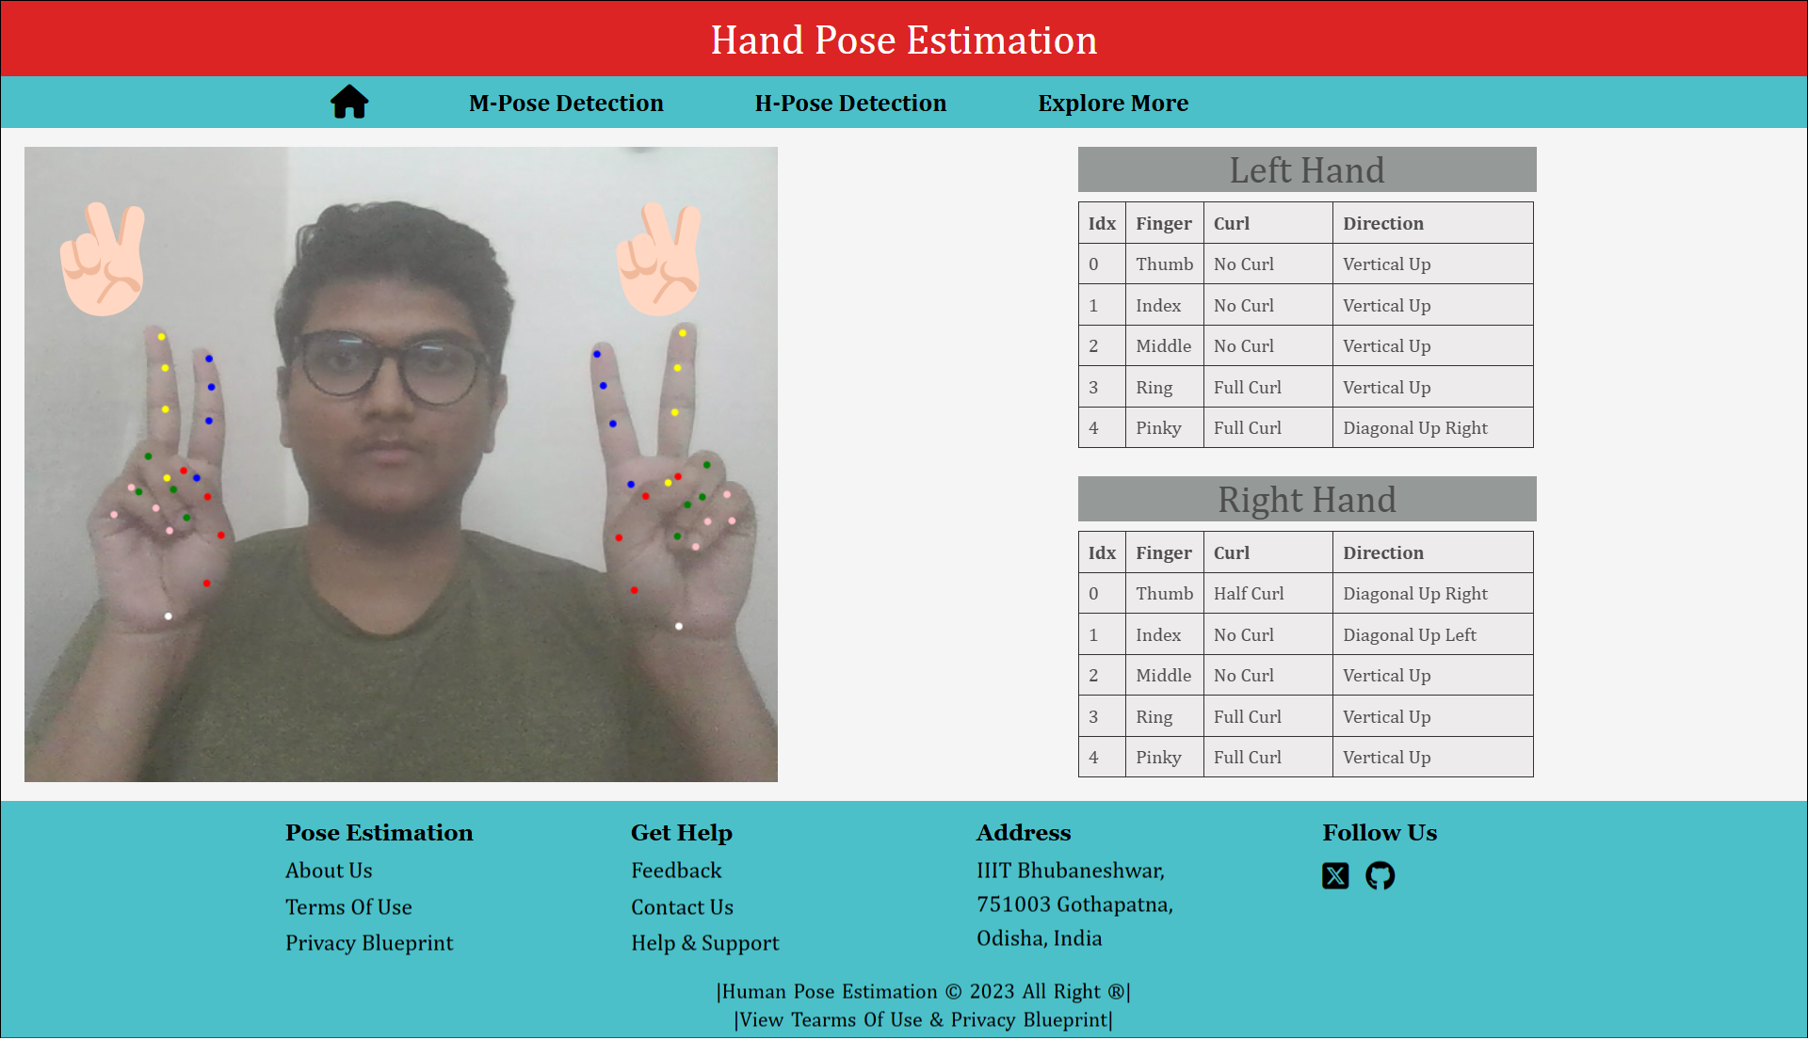
TYPES OF POSE ESTIMATION
‹#›

Slide 7
Libraries/Frameworks and Models
Following are the technologies that we had used to implement the real time human pose estimation project in web browser .
TensorFlow
Mediapipe
Posenet

Slide 8
1. Tensor Flow
Definition: TensorFlow.js is a JavaScript library that enables the training and deployment of machine learning models on the browser and Node.js.
Overview of features: It allows developers to use high-level APIs and pre-trained models, run models in the browser, and create interactive applications with machine learning capabilities.
Links: https://www.tensorflow.org/
Datasets Used : COCO , MPII for pose estimation
300W-LP for face detection
Hand Tracking 21-Keypoint

Slide 9
2. MediaPipe
Definition: MediaPipe is an open-source machine learning framework developed by Google for building real-time applications that process video, images, and audio.
Overview of features: It supports cross-platform deployment (Web, Android, iOS, Desktop) with low-latency inference optimized for CPU & GPU acceleration. Its modular pipeline enables efficient multi-task learning, making it ideal for AI-powered applications in AR, gaming, and healthcare .
Link

Slide 10
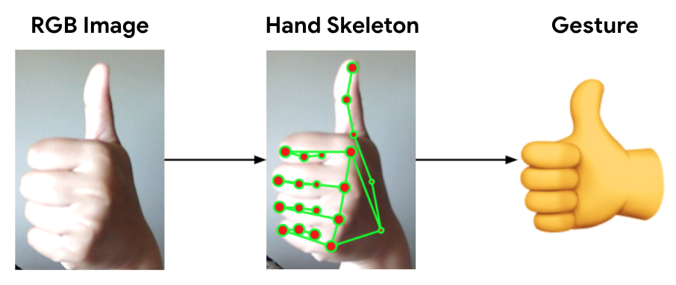
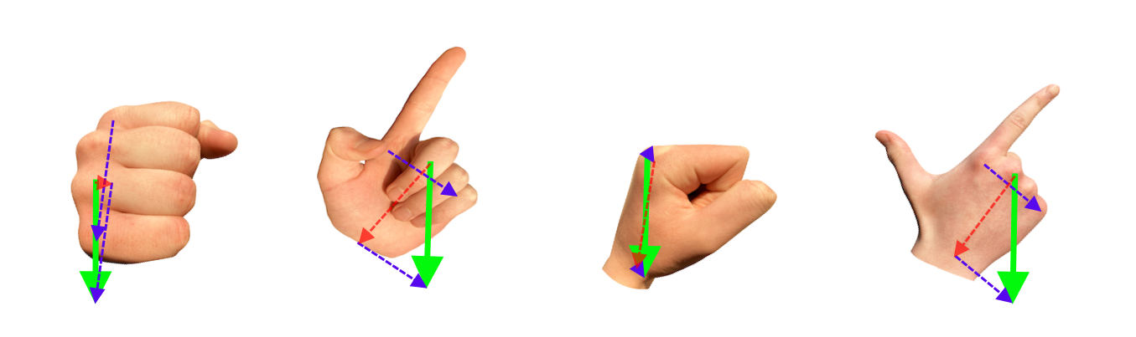
HAND POSE ESTIMATION
Hand pose estimation refers to the task of detecting and localizing the key points (joints) of a human hand in an image or video. These key points usually correspond to the positions of the fingertips, knuckles, and wrist.
Hand pose estimation can have various applications, including gesture recognition, sign language translation, human-computer interaction, and virtual reality.

Slide 11
3. Posenet
Definition: PoseNet is a deep learning-based real-time human pose estimation model developed by Google. It detects keypoints of the human body (nose, eyes, shoulders, elbows, etc.) from images or
Videos .
Overview of features: Optimized for mobile and web applications, it runs seamlessly in browsers using TensorFlow.js and supports CPU, GPU, and WebGL acceleration.
Link

Slide 12
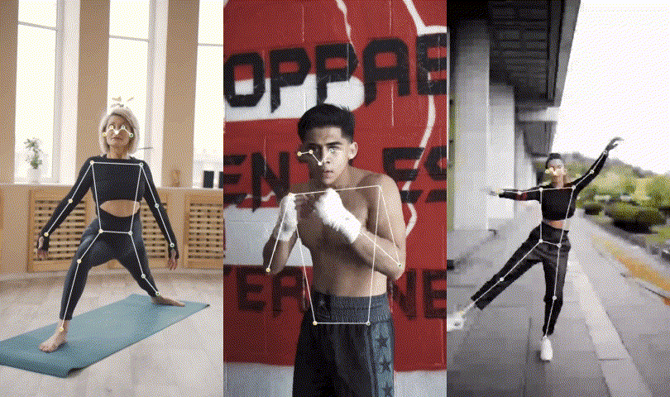
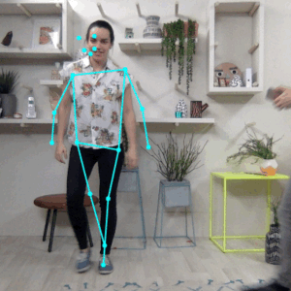
SINGLE POSE ESTIMATION
MULTI POSE ESTIMATION
Pose Estimation can estimate either a single pose or multiple poses, meaning there is a version of the algorithm that can detect only one person in an image/video and one version that can detect multiple persons in an image/video.

Slide 13
FLOW OF THE PROJECT
Data Collection And Data Preprocessing: Since we are using the pretrained machine learning model data collection & preprocessing is managed by tensorflow.js.
Model Selection: TensorFlow.js provides several pre-trained models for this task, including PoseNet and BlazePose.
Integration with Web Browser: This involves loading the model into the browser and configuring it to run on the user's device.
User Input: The user provides an image or a video stream to the web application, which is then used as input to the human pose estimation model.

Slide 14
Inference: The model processes the input image or video stream and predicts the joint positions of the human body.
Visualization: The predicted joint positions are visualized on the input image or video stream in real-time.
Optimization: The model hyperparameters can be fine-tuned to improve its performance on the user's device.
Testing: The web application is tested on different devices and under different conditions to evaluate its performance and ensure that it works correctly.
Deployment: The final step is to deploy the web application, where it can be used by the users to estimate human poses in real-time.

Slide 15
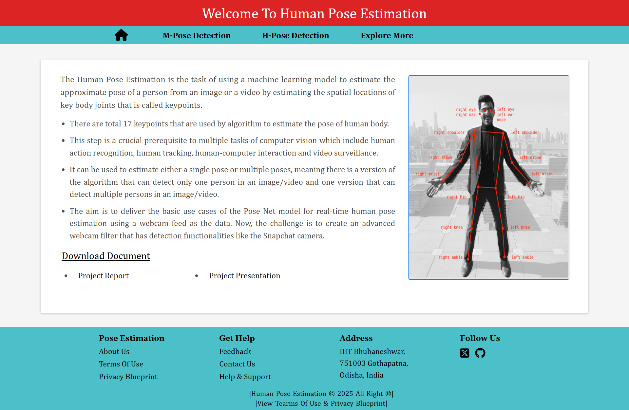
WEBSITE HOME PAGE

Slide 16
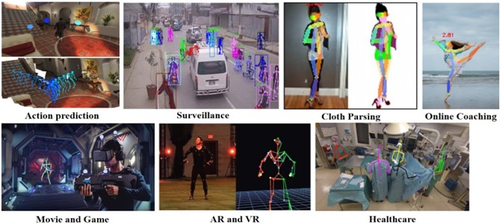
USE CASES

Slide 17
THE FUTURE SCOPE
‹#›
1. Real-Time Pose Estimation on Edge Devices
2. Privacy and Security Considerations
3. Real-Time Feedback and Coaching
4. Collaborative Pose Estimation
5. Self-Supervised Learning
6. Virtual Try-On and Fashion
7. 3D Pose Estimation

Slide 18
CONCLUSION
The aim is to deliver the basic use cases of the Pose Net model for real-time human pose estimation using a webcam feed as the data. Now, the challenge is to create an advanced webcam filter that has the detection functionalities like the Snapchat camera.
Real-time human pose estimation is a developing field that uses computer vision algorithms and machine learning models to estimate the position and orientation of a person's joints in real-time. It has applications in various fields, including virtual reality, gaming, sports analytics, and health monitoring.

Slide 19

‹#›
RELATED LINKS
Figma Design
https://www.figma.com/proto/IwBTcGW9T4qGUhQMAbepp8/Human-Pose-Estimation?node-id=210%3A67&scaling=contain&page-id=0%3A1
Source Code Is Pushed To GitHub https://github.com/sahemant12/HumanBody-Pose-Estimation
Our Pose Estimation Website
https://humanbody-pose-estimation.netlify.app/

